Slide 1
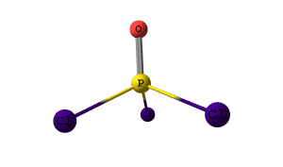
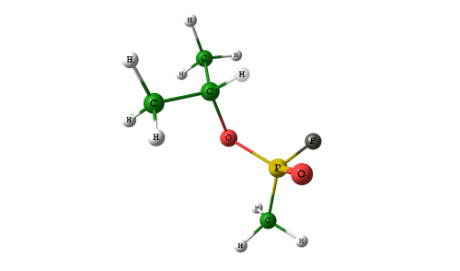
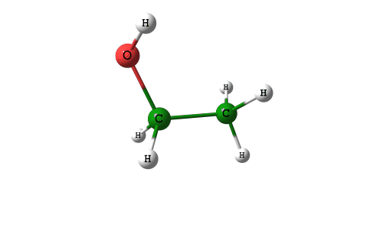
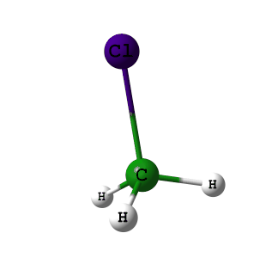
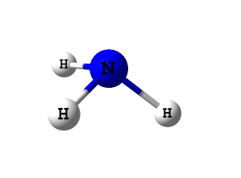
Modeling of spectral signatures using ab-initio calculations
Jeffrey W. Mirick, PhD.
SPIE – Defense, Security, and Sensing Conference - 2010
8 April 2010
Notes:
Today I will present results of the modeling of spectral signatures using ab-initio type calculations. Here are a few of the molecules that I will present in this brief.

Slide 2
Reference
Gas-Phase Databases for Quantitative Infrared Spectroscopy
STEVEN W. SHARPE,* TIMOTHY J. JOHNSON, ROBERT L. SAMS,
PAMELA M. CHU,* GEORGE C. RHODERICK, and PATRICIA A. JOHNSON, Volume 58, Number 12, 2004 APPLIED SPECTROSCOPY
http://nwir.pnl.gov
Sharpe, Steven W. ; Johnson, Timothy J. ; Chu, P. M. ; Kleimeyer, J. ; Rowland, Brad, Quantitative Infrared Spectra of Vapor Phase Chemical Agents, Chemical and Biological Sensing IV, Proceedings of the SPIE, Volume 5085, pp. 19-27, 5085:19-27 (2003)
Notes:
All the lab-measured signatures in this briefing were measured by Pacific Northwest National Laboratory and are available on their web site at www.pnl.gov.

Slide 3
Outline
Introduction
  Why model
  Ab-initio calculations
  Approximations
  Methods
Results
Summary
Notes:
Here is the outline of what I will present, which will include and Introduction, Results and summary

Slide 4
Why model signatures or molecular structures?
Approximate some physical characteristic or properties of materials without having to perform experiments
Approximate vibrational modes
Approximate molecular structures
Investigate reactions between two chemicals
Approximate transitions structures and energy barriers
The key word here is approximation
Notes:
There are several reasons why scientist might want to perform molecular modeling calculations. One reason is to be able to predict certain chemical behaviors, or characteristics, prior to performing expensive or dangerous measurements.
Some of the properties that might be approximated include lowest energy, or optimized molecular structures, transitions structures, energy barriers, modes of vibration, reactions between two molecules. The key word here is APPROXIMATION.

Slide 5
Introduction: Vibrating Molecules
Like marbles held together by many springs, molecules will vibrate, rotate, and undergo other types of motion. The colour of the circles that are in the images represent atoms.
White is hydrogen
Green is carbon
Red is oxygen
Dark grey is fluorine
Gold is Phosphorus
Purple is Chlorine
Notes:
The atoms within molecules are bound together by electric forces. The electric forces occur between electrons and electrons and between electrons and nuclei. The electric force defines how molecules vibrate, rotate, and undergo other types of motion.
In this brief the atoms will be represented by colored circles with each color corresponding to a particular atom.

Slide 6
Approximations
Born Oppenheimer Approximation
  The mass of the nucleus is much larger then the mass of the electron
  Psi(total) = Psi(Nuclear) x Psi(electronic)
Electron correlation functionals used in the density functional hybrid methods
  Pauli Principle
  Difference between HF energy and actual energy
Molecular Orbitals can be expressed as Linear Combination of Atomic Orbitals
Notes:
The 3 basic approximations used in molecular modeling are the Born-Oppenheimer approximation, electron correlation functionals which is used in the density functional methods, and approximating molecular orbitals with a linear combination of atomic orbitals.
In the Bourne-Oppenheimer approximation, the nucleus is assumed to have a mass much larger then the mass of the electron. Once this approximation is made, the electronic and nuclei wave function can be treated separately. The total energy of the system will then be equal to the sum of the electronic energy and the nuclear energy.
Not all the energy is accounted for in the HF approximation. The electrons tend to avoid each other more then what is predicted due to the Pauli exclusion principle.. The electronic correlation energy is the difference between the HF energy and the true energy.
The third approximation has the molecular orbitals being approximated with a linear combination of atomic orbitals.

Slide 7
More Approximations
Overtones and hot bands are neglected
A lineshape centered on the band-center frequency is used to approximate spectral features
The vibrational band centers are shifted by an anharmonic constant (~0.988 to 0.990)
Narrow spectral features (Q-branch transitions) and individual rotational features are neglected
Notes:
Other approximation in evaluating the spectra include neglecting overtones, hot bands and rotational structures, using a anharominic factor in calculating the vibrational frequencies, and selecting a lineshape.
The lineshape is somewhat arbitrary and is chosen to best fit the data.
The vibrational frequency is sometimes referred to as the band center since the frequency corresponds to the center of a vibrational band. The calculated frequency should fall very close to the band center or on top of the Q-branch rotational structure.

Slide 8
Method
Input an approximate structure for the molecule (a guess)
Geometrically optimize the molecular structure until the “global lowest energy” is obtained (not to be confused with local minimum energies)
Calculate the harmonic frequencies (or band-centers) and modes of vibration for the minimum energy structure
Apply the anharmonic correction factor to the harmonic frequency
Approximate the lineshape of the spectral features using a Lorentzian or Gaussian lineshape
Normalization to PNNL signatures
Unless stated differently, the method will be b3pw91/very large basis set
Notes:
There are 3 parts to the input to the application.
A crude approximation of the coordinates of each atom making up the molecular structure
The method and basis set used in the calculation
And the type of calculation – whether it is a full optimization, frequency cacluation, population, transition structure, etc.
The software will then proceed to perform energy calculation and with each iteration of the total energy will move the atoms to a lower energy configuration. This will proceed until the optimization is complete.
Once the optimization is complete, the frequency calculations are made and the vibrational modes calculated. Then the anharmonic factor is applied to the calculated frequencies and the lineshape is added.
In this study the density functional hybrid methods are used with a very large basis set, unless stated otherwise.

Slide 9
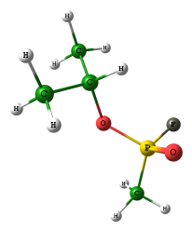
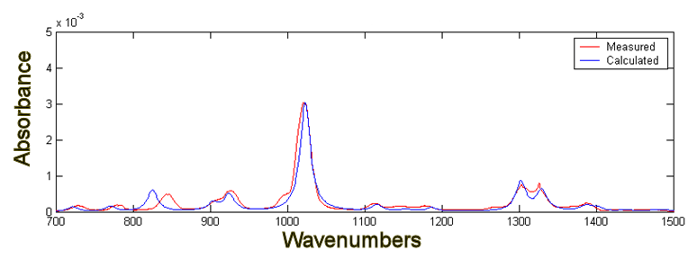
Sarin
Modes of Vibration: Two modes are shown out of a total of 48 modes
Optimized structure
Notes:
Here are results from a full optimization and frequency calculation for sarin. The optimized structure is on the upper left and 2 of the 48 vibrational modes are shown. One mode corresponds to the spectral feature at 1019 wavenumbers and the other is to the feature at 820 wavenumbers. The red will always be the lab-measured spectrum and the blue plot will be the calculated spectrum. The measured and calculated spectrums of sarin are in good agreement.

Slide 10
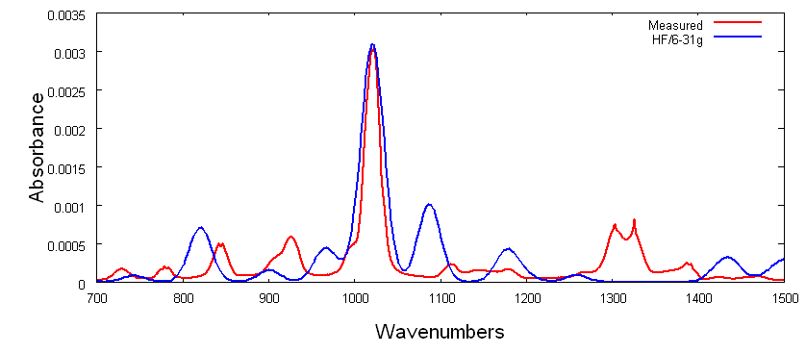
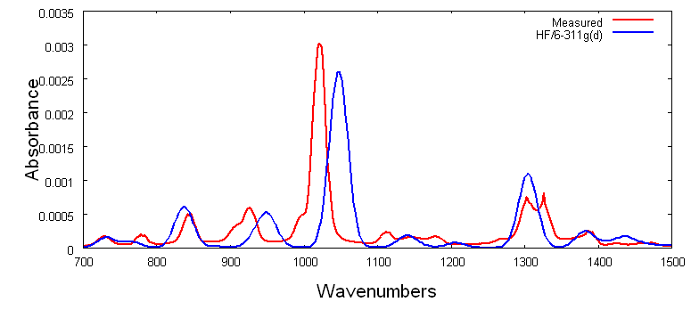
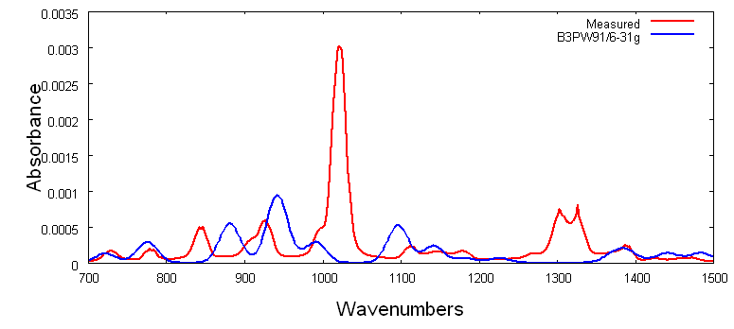
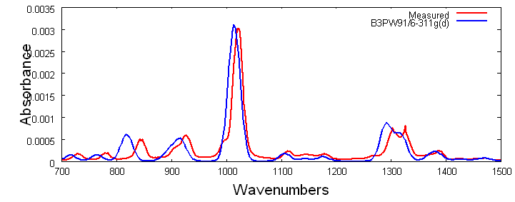
Sarin
Optimized structure
HF/6-31g
HF/6-311g(d)
B3PW91/6-31g
B3PW91/6-311g(d)
Notes:
Here are calculated spectra using different methods and basis sets. The HF with a small basis set and then a larger basis set, followed by spectra using the density functional hybrid methods using a small basis set and then a larger basis set. The plot that gives the best agreement between lab-measured spectrum and the calculated spectrum is the bottom plot where the hybrid method was used with a larger basis set. The hybrid method with a larger basis set will be used in the study.

Slide 11
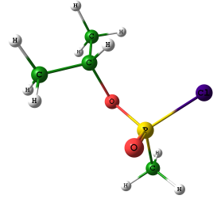
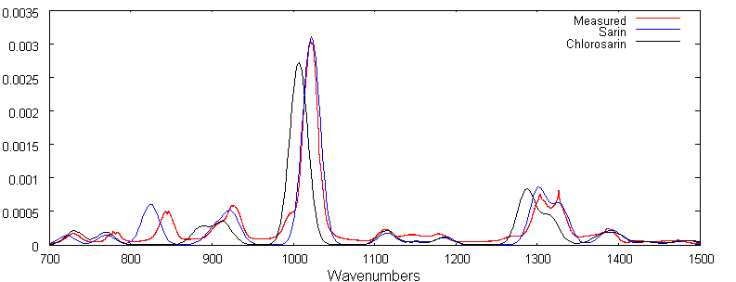
Sarin and Chlorosarin
Lab measured spectral signature of sarin (red)
Calculated spectral signature of sarin (blue)
Calculated spectral signature of chlorosarin (black)
F – 19 u
Cl – 35.45 u
Optimized structures
Notes:
Here s a comparison of the lab spectra of sarin, in red, and the calculated spectrum of sarin, in blue, and chlorosarin, in black. The calculated spectrum of sarin and chlorosarin are very similar, except for the feature at 820 wavenumbers. The only difference between the two molecules is that the fluorine atom was replaced with the chlorine atom. Since the mass of chlorine is larger then the mass of fluorine, the frequency at about 820 wavenumbers has been shifted to lower frequencies.

Slide 12
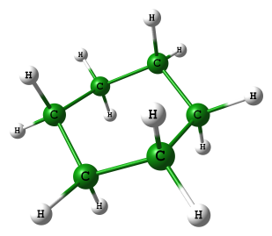
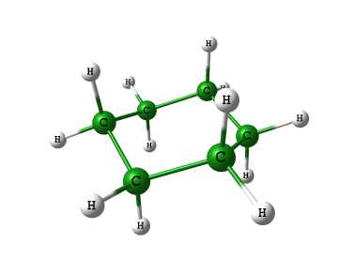
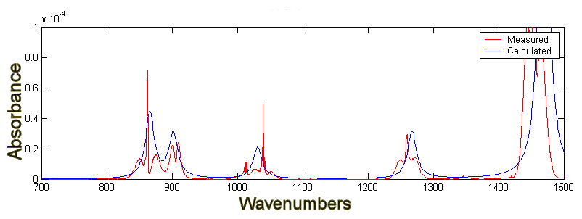
Cyclohexane
Point Group: C2h (Rotation by 180 degrees/reflection)
ROTATIONAL CONSTANTS (GHZ)
4.33652 4.33429 2.47497
Optimized structure
“Chair” conformation – Lowest energy state – most stable
Notes:
The Q-branch of cyclohexane is very visible in this spectral signature, along with the p and R rotational branches. The overall appearance of the spectrum, relative amplitudes and line position are a close fit to the measured spectrum.
The vibrational mode of the larger amplitude feature is also shown.

Slide 13
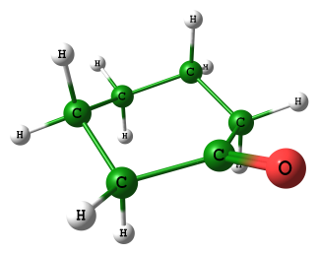
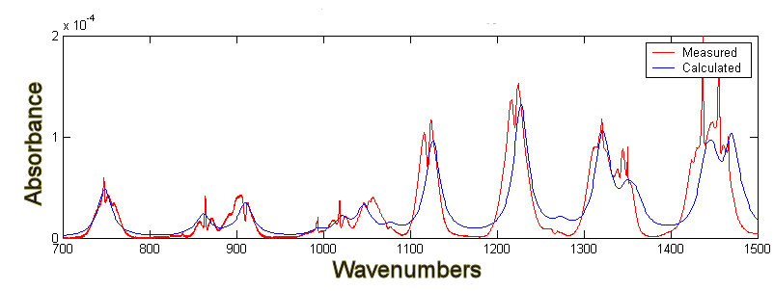
Cyclohexanone
Point Group: Cs (Reflection)
ROTATIONAL CONSTANTS (GHZ)
4.24016 2.50570 1.75457
1072, .00043
Optimized structure
Notes:
There is good agreement between measured and calculated spectra for cyclohexananone.

Slide 14
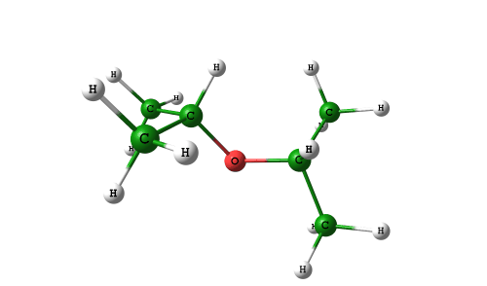
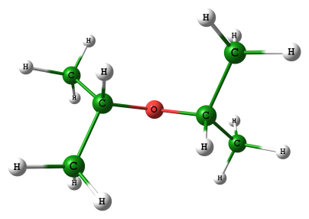
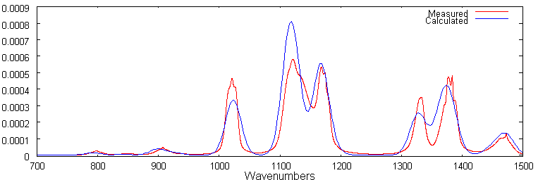
Diisopropyl ether, DIPE
ROTATIONAL CONSTANTS (GHZ)
4.11436 1.55006 1.38152
1120, .000575
Optimized structure
Notes:
There is good agreement between measured and calculated spectrum for diisopropyl ether.
Vibrational mode shown for the largest amplitude feature.

Slide 15
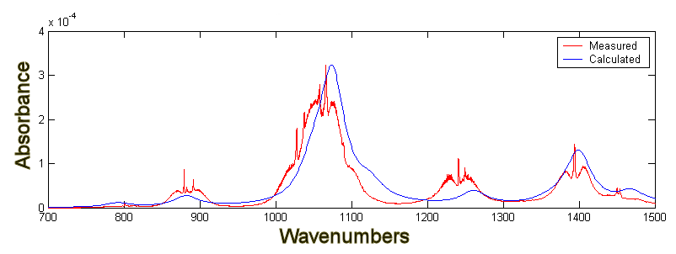
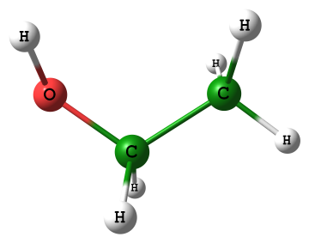
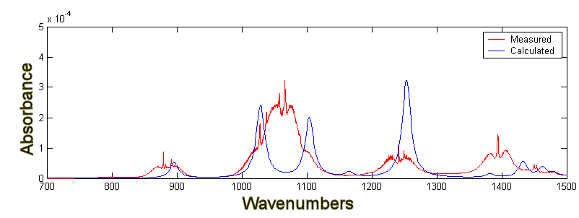
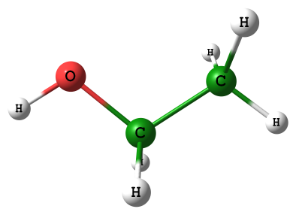
Ethyl alcohol
Optimized structure
Correct isomer
Optimized structure
Wrong isomer
Notes:
Here we have two different minimum energy structures; however only the top one results in a good match between measured and calculated.
The vibrational mode of the largest amplitude feature is also shown.

Slide 16
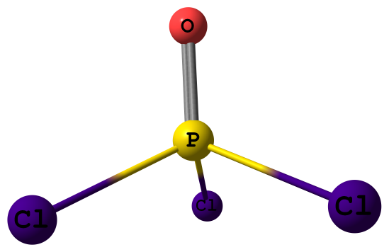
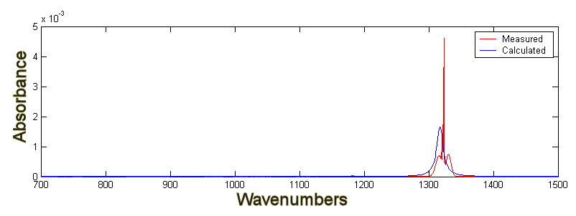
Phosphorus oxychloride, POCl₃
Optimized structure
Point Group: C3v
ROTATIONAL CONSTANTS (GHZ)
1.99438 1.99438 1.45367

Slide 17
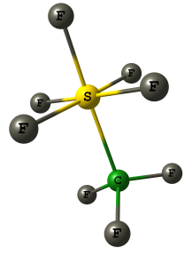
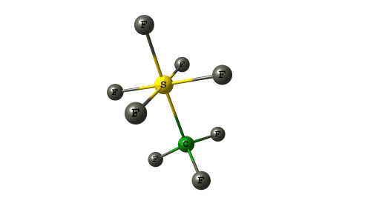
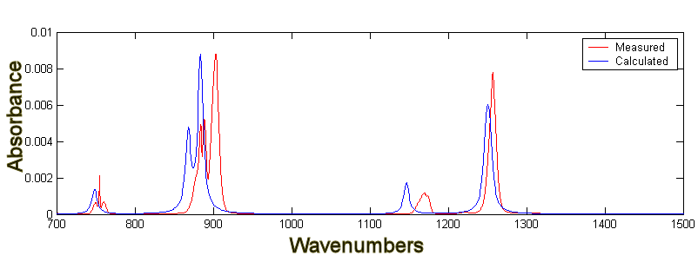
Trifluoromethyl sulfur pentafluoride, CSF₈
Optimized structure
Point Group: Cs
ROTATIONAL CONSTANTS (GHZ)
1.81037 1.08398 1.08348
The small frequency bias toward lower frequencies is due to an anharmonic factor that was too small
Notes:
Although the general line shape of the spectral signature for this molecules is in close agreement to the measured spectrum, the features are biased toward the higher frequency. This would seem to indicate that the anharmonic factor should be larger.

Slide 18
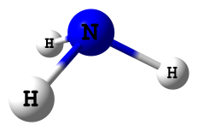
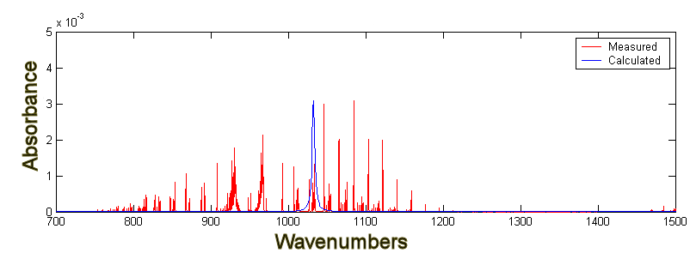
Ammonia, NH3
Point Group: C3v (rotation by 120 degrees/reflection)
Vibrational-rotational structure become more complex due to the ability of the molecule to invert
More then 100 spectral features in LWIR
Impossible to model
The spectra below shows the modelled, broadened anharmonic frequency overlaid on the signature of ammonia
Optimized structure
Notes:
Modeling does not work for every molecule. What is calculated is the bandcenter (vibrational) frequency for a particular vibrational band. This is what I did for ammonia. The band center frequency is as indicated, however, since the nitrogen atom undergoes quantum mechanical tunneling the net effect is to have several lines centered around the calculated frequency.

Slide 19
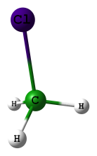
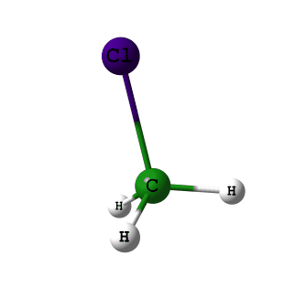
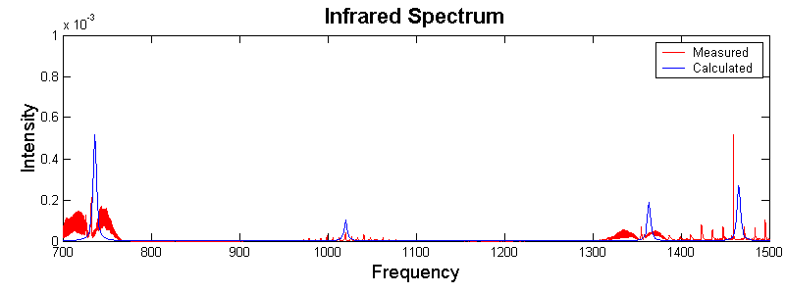
Methyl chloride
C3v
ROTATIONAL CONSTANTS (GHZ)
157.64223 13.37060 13.37053
Optimized structure
The calculated band center frequency (blue) for the 3 vibrational modes are shown with the lab measured spectra (red).
The calculated band center frequency for both modes of vibration falls very close to the Q branch rotational structure.
The P and R branches of the rotational structure extend outward from the band center, due to a relatively large rotational constant.
This molecule is not a good candidate for modeling due to the spectral extent of the P and R rotational branches,.
Notes:
Methyl chloride has a relatively large rotational constants, therefore, the rotational structure is visible in the measured spectrum. However, the calculated band centers for this molecule, corresponding to the line position of the Q-branch in the measure spectrum, is right on target.

Slide 20
Summary
Ab-initio methods can be used in the calculation of spectral signatures for many molecules
In general, better calculations are achieved with smaller rotational constants (larger molecules)
For many molecules, identification can be made by comparing the spectral signature of known molecules with that of unknown molecules.
The modeling of spectral signatures can be useful in the identification when there are no other lab measured spectral signature available to make an identification.
Notes:
To summarize
Ab-initio methods can be used in the calculation of spectral signatures for many molecules
In general, better calculations are achieved with smaller rotational constants (larger molecules)
For many molecules, identification can be made by comparing the spectral signature of known molecules with that of unknown molecules.
The modeling of spectral signatures can be useful in the identification when there are no other lab measured spectral signature available to make an identification

